Slide 1
goFIT Project Recap
Notes:
Project title and team

Slide 2
Team FITLIT
Olivia Gregory
Bryce Tham
Christian Valadez
CJ Keller
Previous members: Christina Ramsey & Denis Russu
Notes:
To start real quick I’m going to introduce Team FITLIT, which is me, Olivia, Bryce, and Denis.
I’m also going to do a quick refresher on out problem/solution overview and value proposition before starting with the new material that will be the focus of this presentation.

Slide 3
Problem Overview
Although many people want to stay healthy, they rarely prioritize their health, saying they don’t have time, don’t want to wait for the long-term benefits, didn’t find regular exercise exciting/enjoyable, or were mainly motivated through social connection.
How might we get people more excited about the idea of exercising?
How might we structure exercise around the lifestyle of busy people?
How might we make exercise more social?
Notes:
Based on our needfinding interviews at the beginning of the quarter, we articulated the following problem overview:
Although many people want to stay healthy, they rarely prioritize their health, saying they don’t have time, don’t want to wait for the long-term benefits, or prefer to do other, more social, activities.

Slide 4
Solution Overview
We want a product that offers meaningful social connection and immediate rewards when users meet fitness and nutrition goals.
This should motivate people to be more excited about maintaining a healthy lifestyle, demonstrating that the act itself - not the incentives - is worth prioritizing.
Notes:
So in response, we developed the following solution:
We want a product that offers meaningful social connection and immediate rewards when users meet fitness and nutrition goals.
This should motivate people to be more excited about maintaining a healthy lifestyle, demonstrating that the act itself - not the incentives - is worth prioritizing.

Slide 5
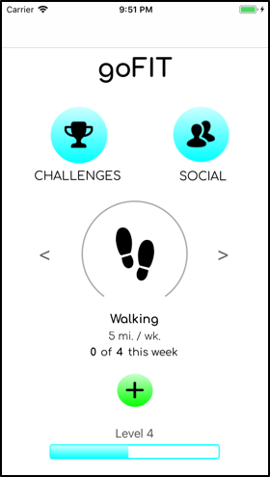
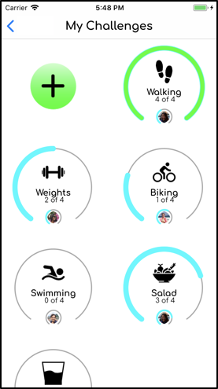
Introducing goFIT
goFIT is a new way to stay healthy, be social, and accomplish goals.
Set goals
Log progress
Challenge friends
Notes:
High level solution with images

Slide 6
Outline
Concept Video
Design Evolution
Representative Tasks
Live Demonstration
Future Enhancements
Summary
Notes:
Outline of talk)

Slide 7
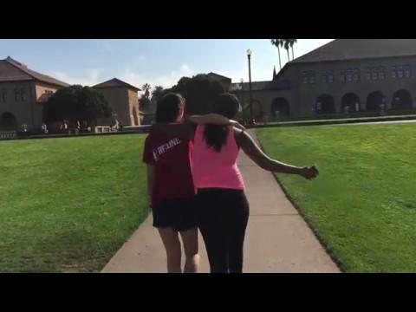

Slide 8
Design Evolution
Notes:
Project title and team

Slide 9



Needfinding
College Students & Recent Graduates
Recreational Fitness Hobbyists
Healthcare Workers & Professionals
Notes:
We interviewed a total of 7-8 people. College students and recent graduates are just now taking care of their own health by themselves. Recreational fitness hobbyists have developed healthy habits to keep themselves in shape. Healthcare workers and professionals have extensive experience and knowledge in the health field.

Slide 10
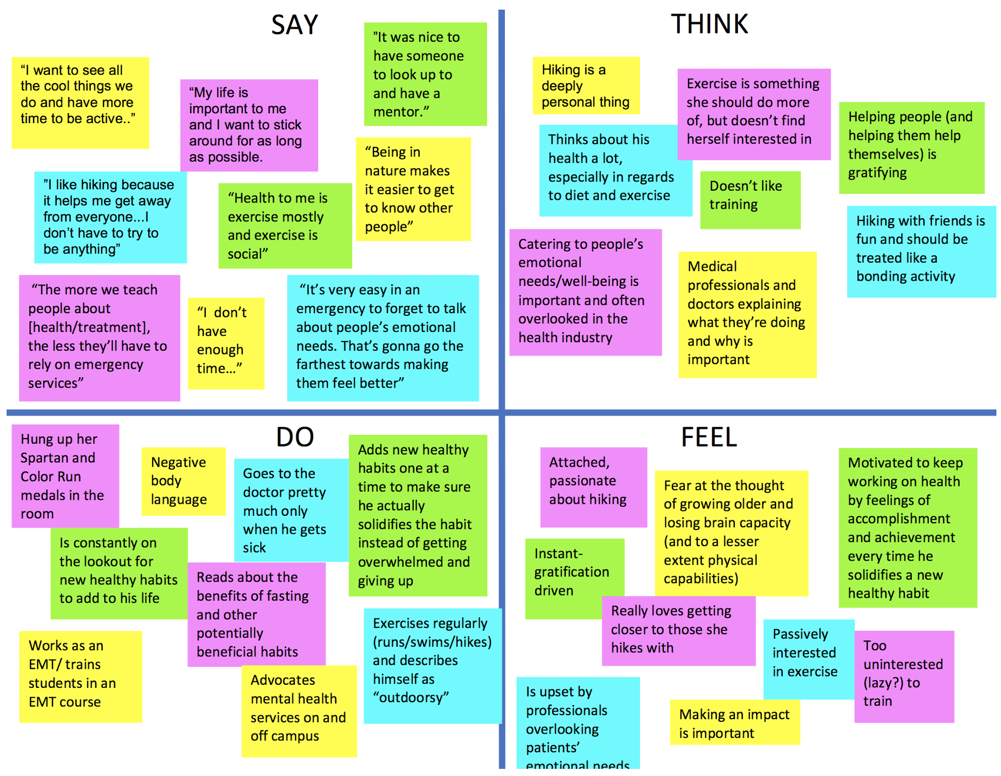
Empathy Map
Notes:
Here is an empathy map of our findings.

Slide 11
Interesting Quotes
“My life is important to me and I want to stick around for as long as possible.”
“The more we help people understand health and treatment, the less they’ll have to rely on [emergency services].”
“I get more out of exercising knowing that I’m doing it with other people.”
“I feel like I don’t have enough time to do all the work it takes to reach my goals.”
Notes:
Here are some interesting quotes that the people we interviewed shared with us.

Slide 12
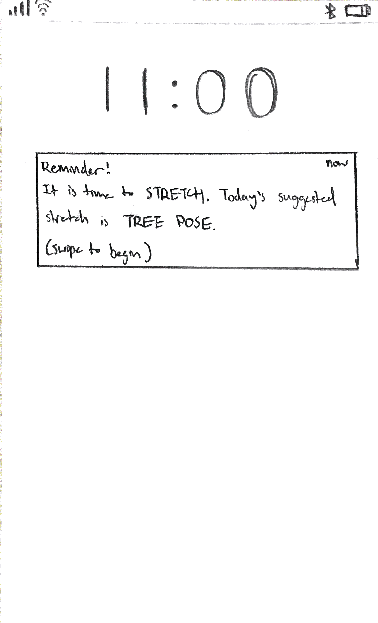
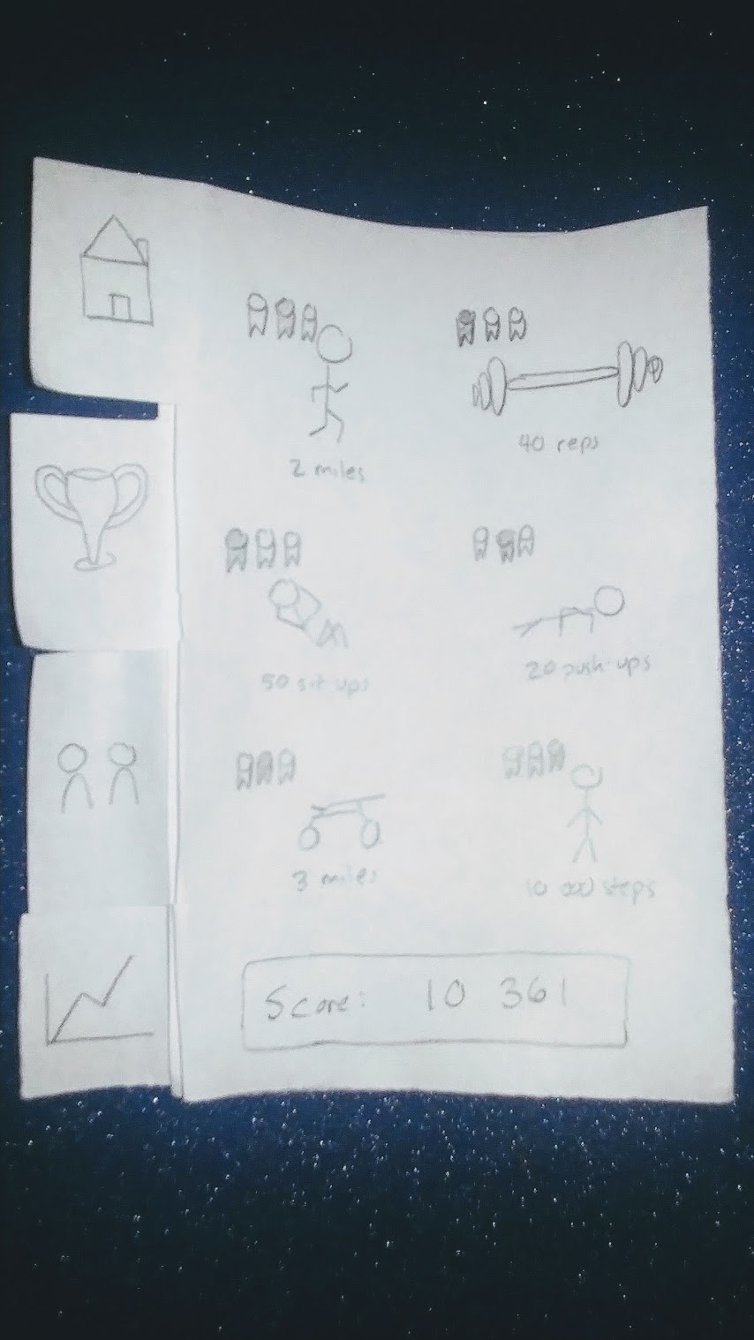
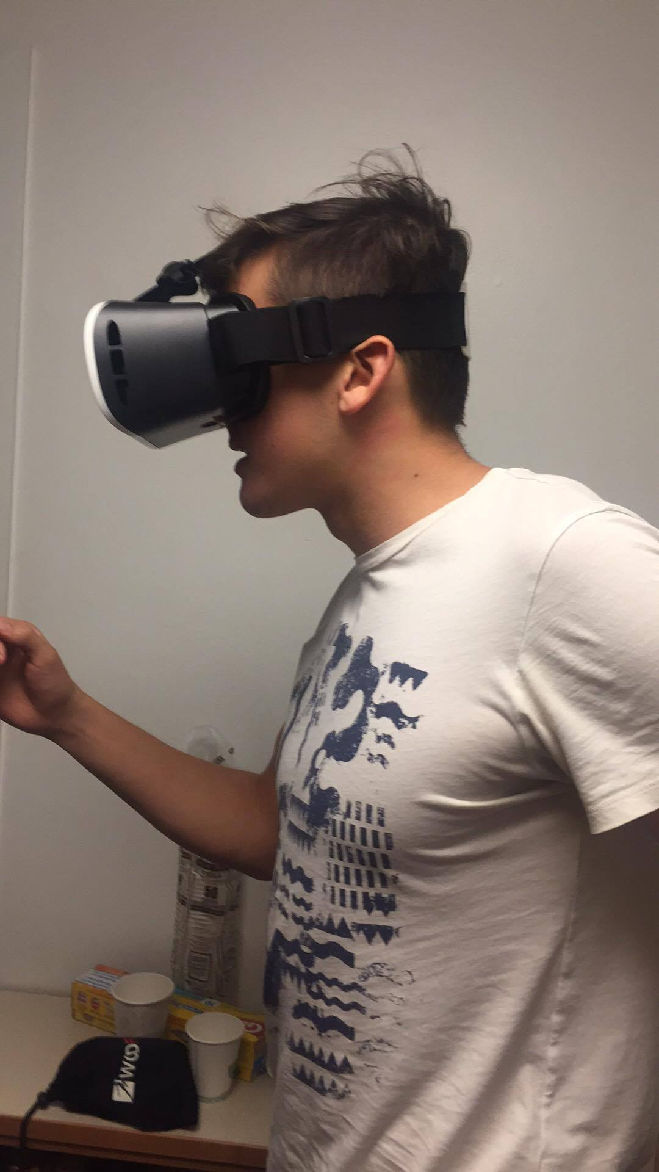
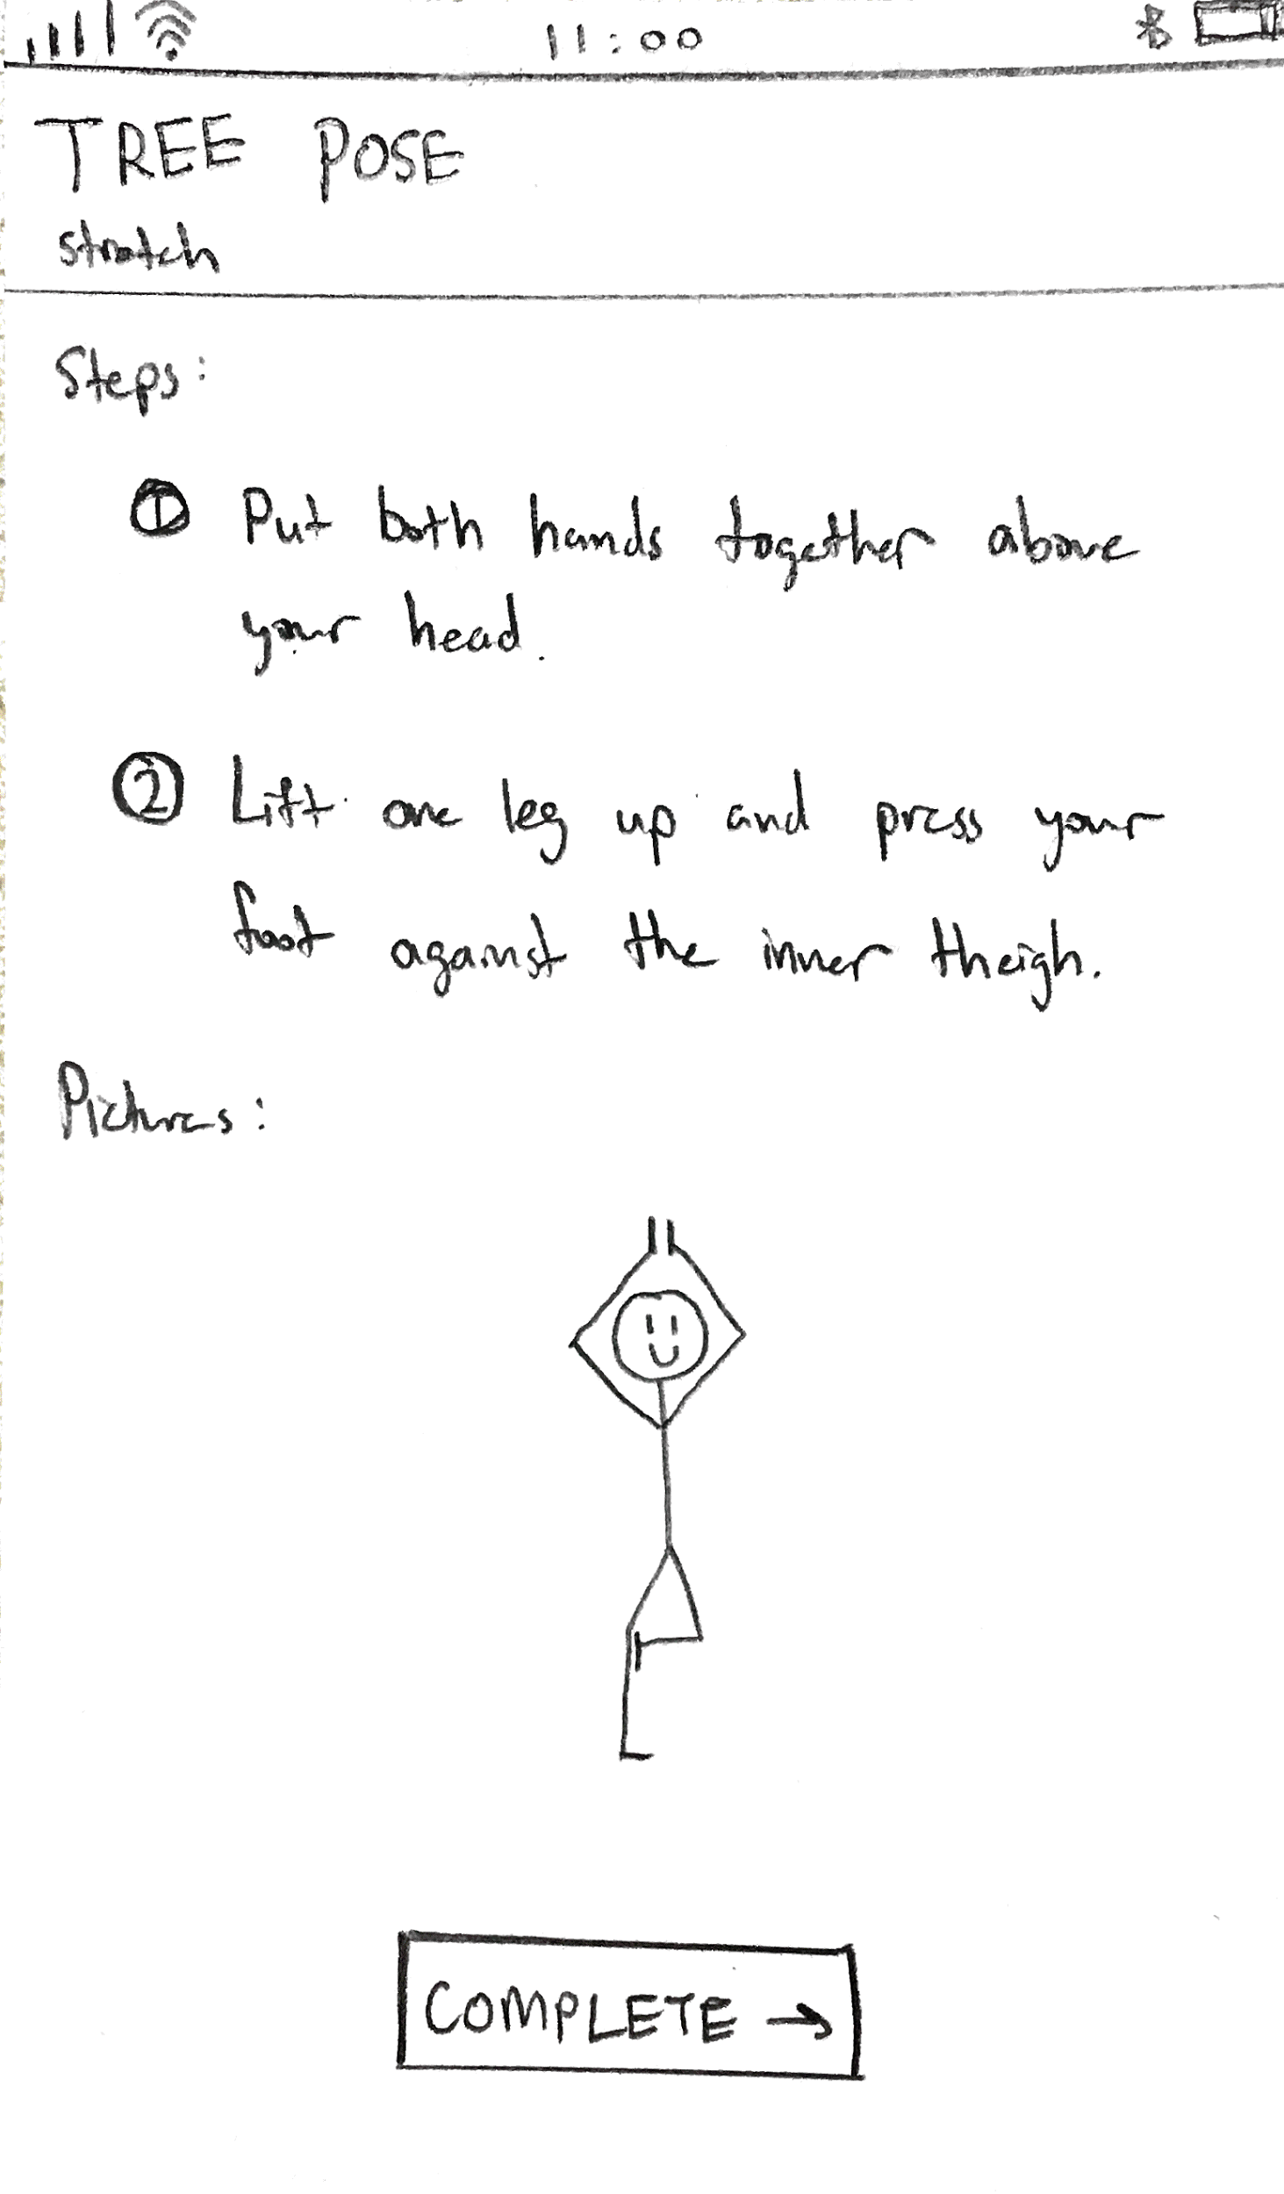
Experience Prototypes

Slide 13
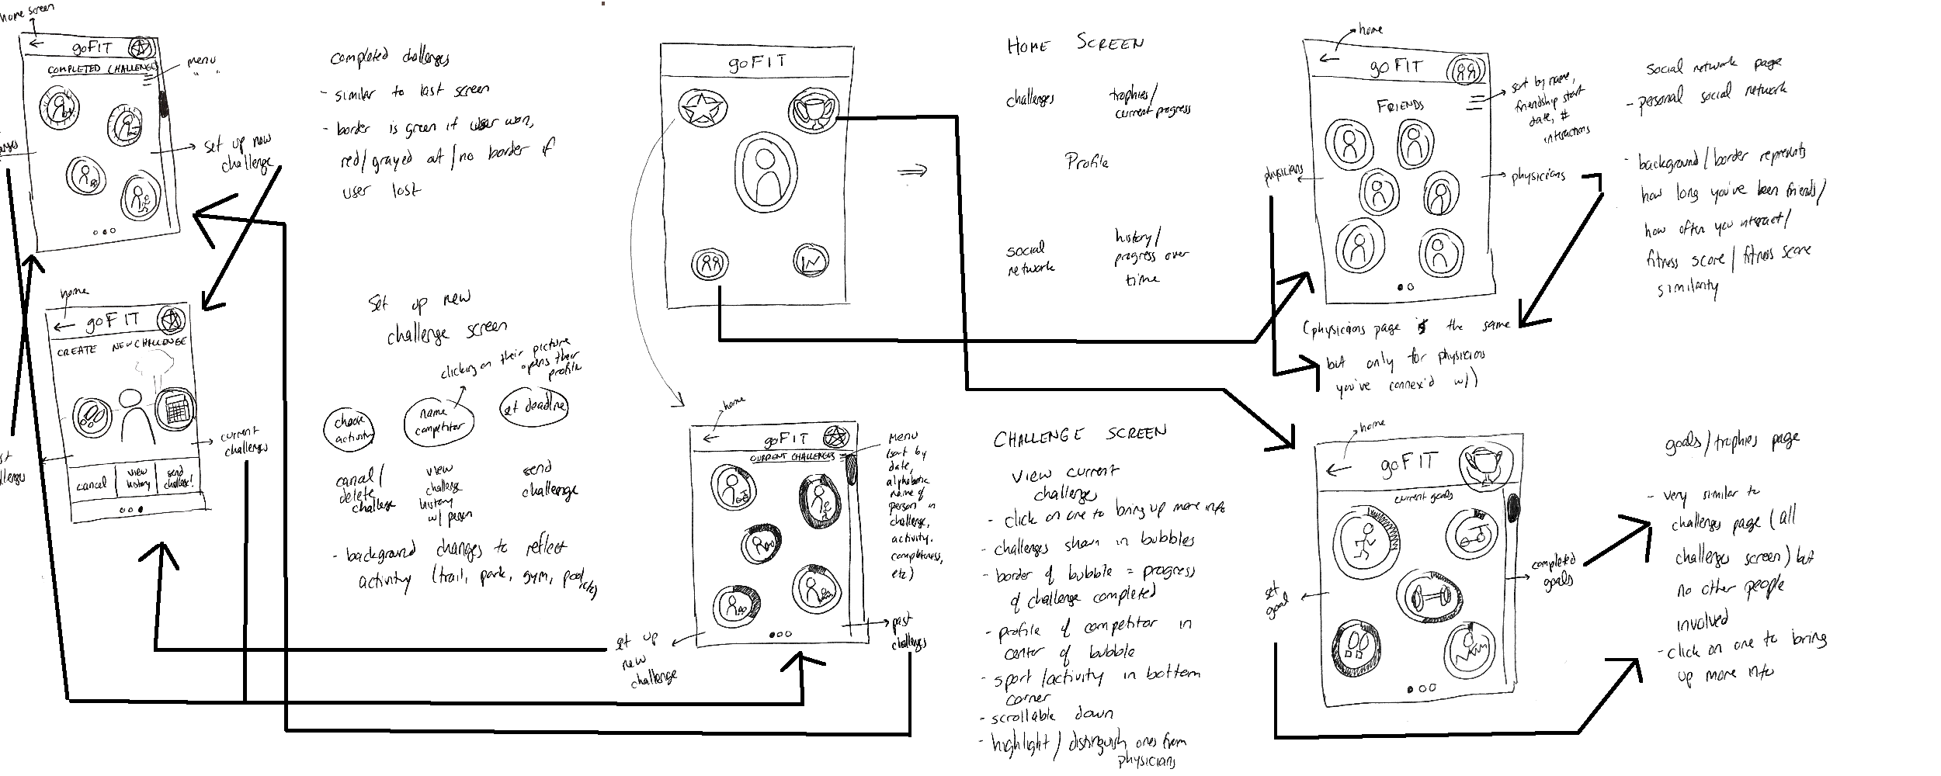
Low-Fi Sketch
Notes:
Chose the best concepts from our brainstorms to draw out in detail.
Bubble Mobile:
This-idea-is-image-oriented, focusing-on-easy-navigation. It-is-simpler, emptier, and-prioritizes ease-of-use, with-the-experience-based-around-a-single, central-dashboard.
Other Design (Boxy), Not shown:
This-idea-was-goal-heavy,-focused-on-giving-the-user-as-much-information-as-possible-and allowing-them-maximum-control-over-their-experience. The-design-is-tabular, image-heavy, and navigable-by-menu.
WHY WE CHOSE BUBBLE (RATIONALE IS IMPORTANT, IT’S ON YOUR RUBRIC):
Eventually our bubble mobile design won, since ease of use and approachability were our most important factors. While our product will absolutely have all the data and history accessible for expert, we wanted the primary interface to be easily navigable and friendly, allowing new users easy access.
Feedback from interviews showed that many want to exercise but don’t. We want users to feel rewarded when they track, progress on, and complete challenges; we don’t want using our app to be a challenge in and of itself.
We also considered that we want users to constantly have our product readily available, which is why the mobile app design won. Finally, we liked that the circular design had a more defined personality and felt less generic than the first.

Slide 14
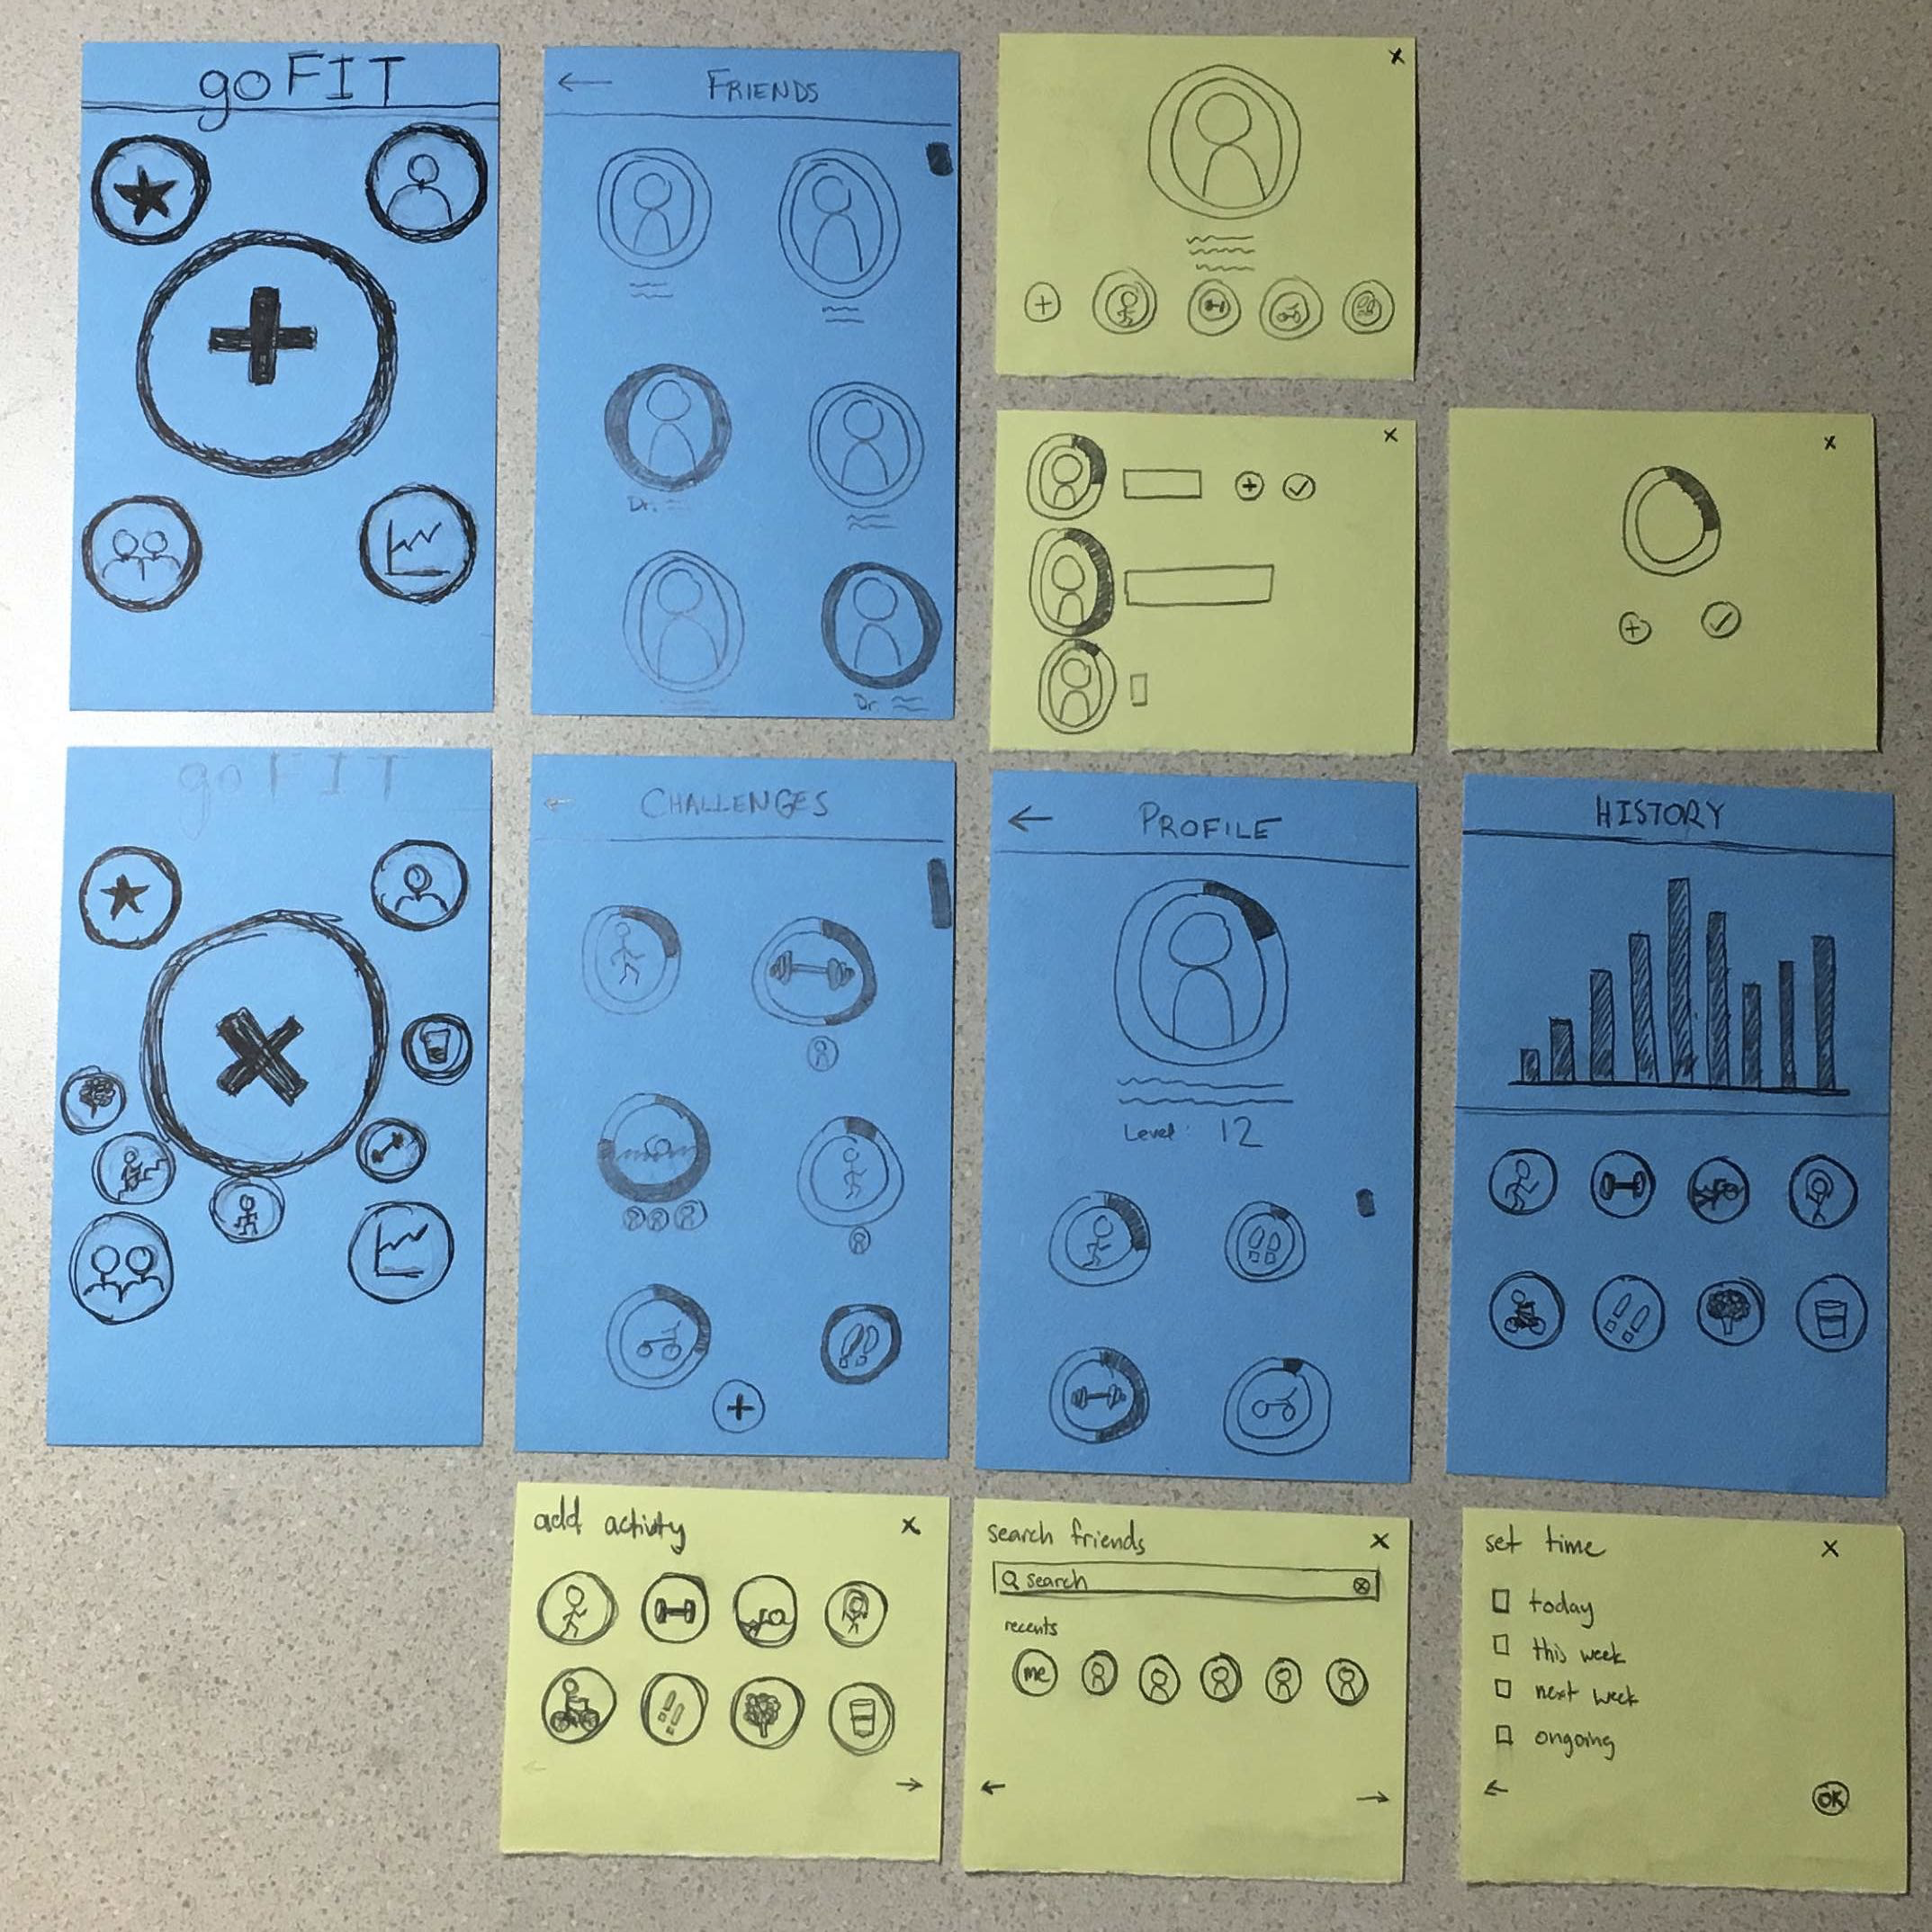
Low-Fi Prototype
Low-Fi Test Results
Testers didn’t understand that they could access challenges by hitting the “+” button on the main screen.
Users wanted a way to subtract from progress, in case they accidentally logged progress.
Notes:
Our prototype mimics a mobile based interaction. GPS sensors in the phone will allow it to track some activity (going for walks, bike rides, runs, hikes, etc) and automatically log those activities and progress. It also allows users to manually input fitness and dietary information as well as challenge friends in meeting fitness goals.
Ultimately, our-prototype-mimics-a-mobile-app-that-logs and-tracks-workouts. Since this is our focus, it is emphasized in our dashboard.
Users can track current and past challenges, as well as create new ones.
Users create a personalized profile shareable with friends.
Users build a network of friends/physicians who become a part of their experience.
They can track personal progress and fitness history.
Altogether, we are expecting each of these functionalities to contribute to our value proposition, inspiring users to maintain healthier lifestyles.

Slide 15
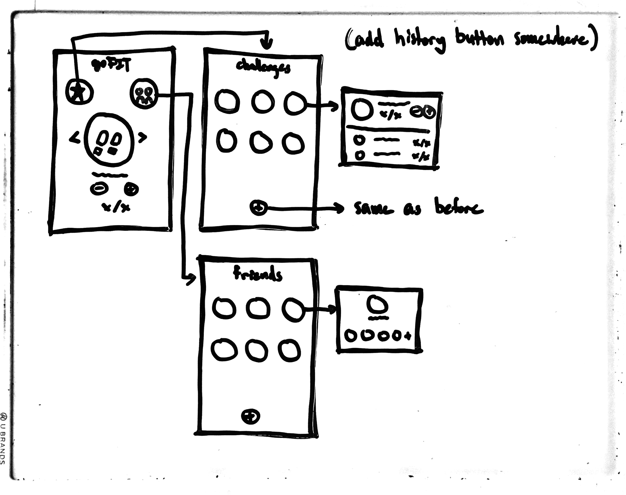
Medium-Fi Changes
Complete redesign of our main screen.
Removing the “+” button entirely.
Adding scrollable challenges directly to the main screen.
Adding a “minus” button.

Slide 16
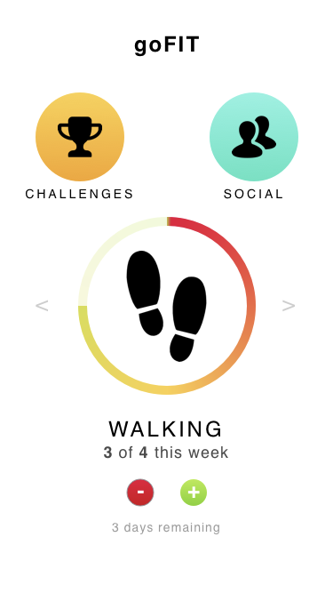
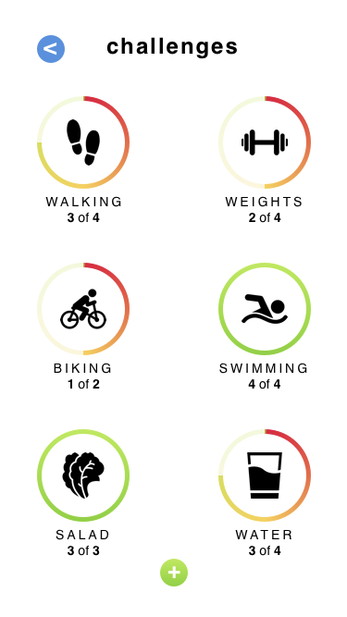
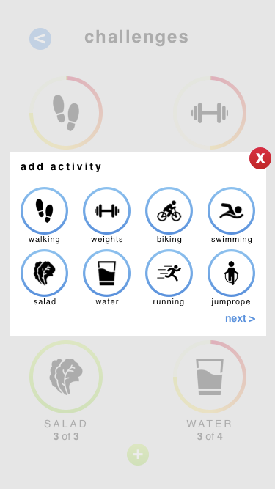
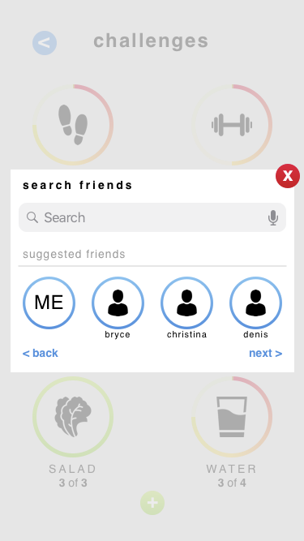
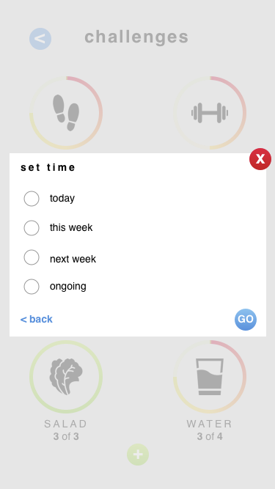
Medium-Fi Prototype

Slide 17
Heuristic Evaluation
At the time setting page, what time we are setting should be clearly notified.
Is this time the due date?
Is it the time we are supposed to start the activity?
Additionally, the deadlines of challenges are unclear.
Does the user have to complete a week after they accept it or a week after they receive it?
What the challenges are supposed to involve is a bit unclear.
On the homescreen, for instance, there’s a symbol representing a challenge to walk 4 times this week, but there is no information about how far the user is expected to walk.
Notes:
We received 2 severity 4 violations, which we knew that we definitely needed to address.
The first was about confusion over our time setting page, which was the last step in creating a challenge. We had originally envisioned that here, users would be able to set a deadline to complete a challenge, but our evaluators were rightfully confused by it’s function, what it meant, and how they should be using it.
They noted in particular that they weren’t sure whether they were setting the start or end time of the challenge, especially in regards to challenging friends and letting them start the challenge with you.

Slide 18
Heuristic Evaluation
How do you receive, accept, or reject challenges/friends?
Visibility of System Status
What is the green button for on the social page?
Consistency and Standards
How do you incentivize health without a defined rewards system?
Aesthetic and Minimalist Design
What happens if a challenge is failed?
Help and Documentation
Why isn’t there a way to see what options a user has chosen while creating a new challenge?
Visibility of System Status
Notes:
We also had a few severity 3 issues. These were
How do you receive, accept, or reject challenges?
What is the green button for on the social page? Is it for creating challenges or adding friends?
How do you incentivize health without a defined rewards system?
What happens if a challenge is failed?
Why isn’t there a way to see what options a user has chosen while creating a new challenge?
This is all good feedback and brought up some good points, so we definitely revised our design to encompass fixes.

Slide 19
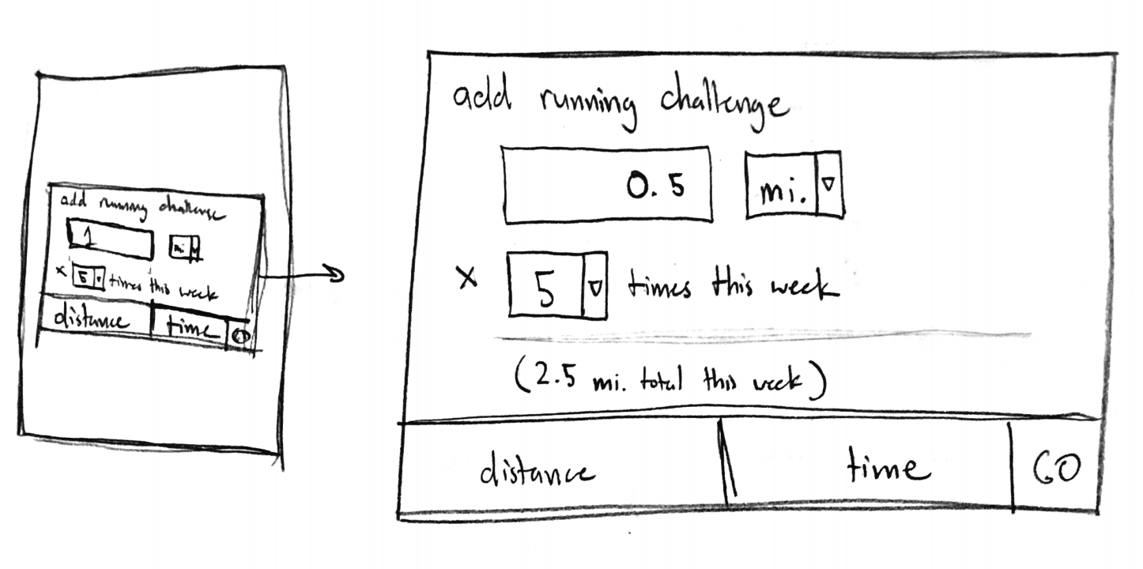
High-Fi Changes
Remove “set time” screen
Make all challenges weekly
Define challenges in terms of distance (if applicable) or time
Notes:
We came up with a few changes to address these issues. The first was to remove our “set time” screen. Instead, we would make all challenges start at the beginning of the week and end when that week was up. We also changed the benchmark for what challenges involve.
Now users keep track of distance they want to cover, or some other applicable benchmark, like reps or weights for weightlifting or ounces for drinking water.
They could also choose to work for some amount of time, like going for a walk for 15 minutes.
We thought this was still flexible even though it was less open ended and more clearly defined. Before, it would be easy for users to flake on a running challenge - if they went for a run that was half of the distance or time they had in mind, they could still log it. It’s also explicit what they have to do in order to reach their goal for the day, which is more clear and less overwhelming.

Slide 20
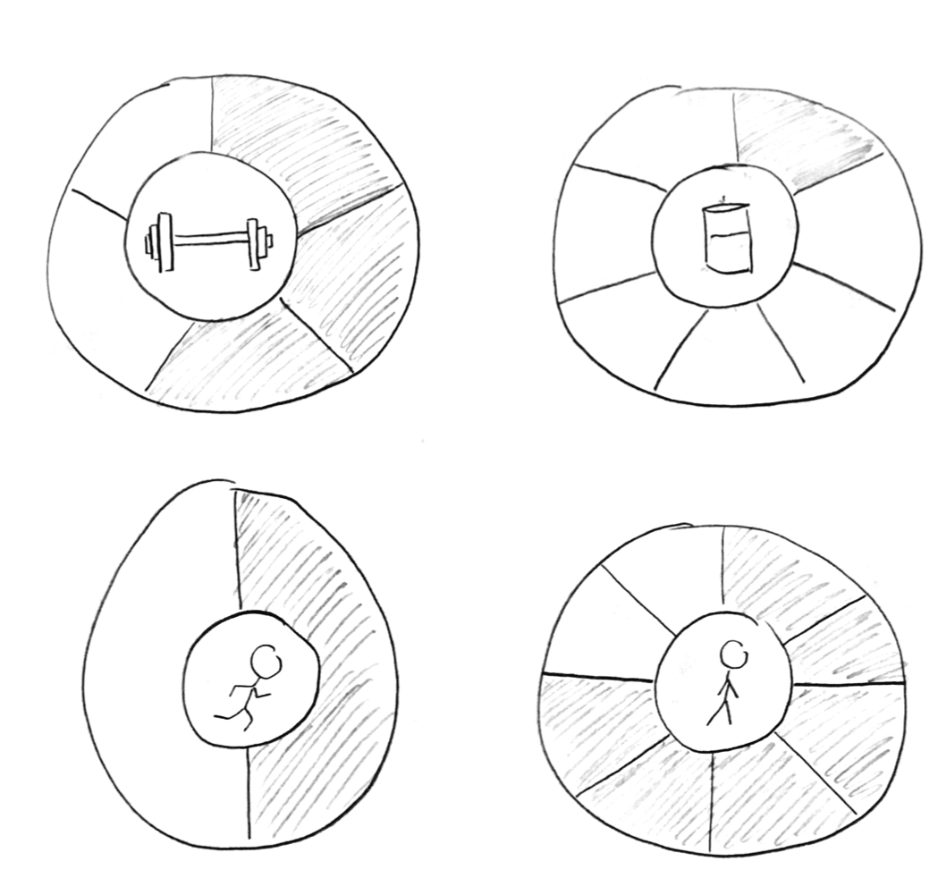
High-Fi Changes
Track progress in terms of what you do
Standardize challenge deadlines
Better way of displaying progress
Easier for scheduling
Easier for understanding
Easier for keeping track
Notes:
The second change we came up with was modifying the way progress was shown visually,
Here, we split up the border into segments where 1 segment means 1 time that you want to perform that activity per week. When you perform that action, one more border slot gets filled in.
It’s still an easy way to track progress.
It’s also less overwhelming - the goal isn’t to complete the entire border at once, it’s to fill in one segment at a time. It’s easier to think of progress in terms of “I completed the activity that I’d allotted to for today” or “this is all that I need to do to stay on track today.”
The second change we came up with was modifying the way that progress is shown visually per challenge.
Border is split up - 1 segment per time that you want to perform that activity that week
Weights 5x week
Drink enough water 7x week
Go for a run 2x week
Walk for at least x amount of time 8x week
This is just a sketch - more information about the specific goals of the challenge would be available in the prototype and when clicked to get more information
The idea here is that each time you perform this action, one slot of the border gets filled in
It’s still an easy way to visually track your progress
The goal isn’t to complete the entire circle at once, which could be overwhelming - it’s to fill in some portion of the border at a time. That way, if you want to do something 7x a week, it won’t be as disheartening as seeing a barely filled progress bar at the beginning of the week. It’s easier to think of progress as in terms of “I completed the goal that I had allotted for today” or, if you haven’t done it yet, “this is all I have to do today to stay on track towards my goal.”

Slide 21
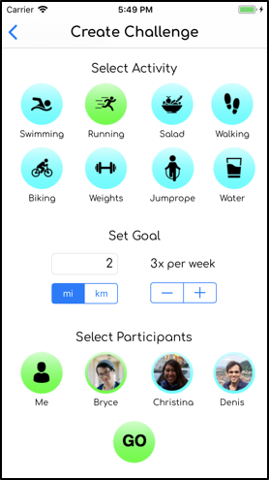
High-Fi Prototype
Notes:
Novice Users -
Streamlining Challenge Creation- One improvement we made was combining all the steps of creating
a new challenge into one screen, thereby reducing the number of screens required to complete
the process.
“Failure” -- We felt that we wanted our application to be friendly and helpful, and punishing users
for not accomplishing their goals goes against that principle.
Defined rewards system - First, we created
a leveling system based on progress and challenges completed. Second, we added redefined
each challenge card as a separate screen that would show historical progress on that particular
activity (as seen above).
Deleting progress

Slide 22
Representative Tasks
Create personal challenges
Invite friends to complete challenges with you
Log progress on fitness and nutrition goals

Slide 23
Create
Personal
Challenges
Medium
Easy for the user to create
Requires personal accountability
Important for our design
Creates personal motivation
Allows for goal tracking
Provides reward - sense of accomplishment - when completed
Specified for testing purposes:
“Create a personal walking challenge for this week!”

Slide 24
Invite
Friends to Complete Challenges
Complex
Should also be easy for the user to create
Comes with personal and social accountability/pressure to finish
Requires connecting with network of friends/physicians
Important for our design
Creates personal motivation - want to win
Tangible reward with real people when completed
Having a network allows physicians to check in with you and friends to keep you working towards your goals
Specified for testing purposes:
“Invite Christina to complete a swimming challenge for next week!”

Slide 25
Log
Progress on Fitness and Nutrition
Goals
Easy
Interviews say people hate doing this
Should be incredibly easy to complete or people won’t do it
Important for our design
Allows users to see long term benefits via personal history
Seeing short-term progress motivates regular activities and accomplishments
Good way for users to stay healthy - incremental progress doesn’t drastically change their lifestyles
Specified for testing purposes:
“Log that you went for a walk today!”

Slide 26
Live Demonstration
Notes:
Demo

Slide 27
Possible Future Enhancements
Scale backend to include real data of people and activities.
Finish implementing incomplete features such as notifications and friend requests.
Flesh out activity creation process.
Update the chart screen to better visualize historical data.
Notes:
Ideas for future enhancements (multiple slides):
Scaling
Finish implementation of everything
Choose any type of challenge
Adding Friends
Accepting requests
Levels
Make friend’s page table view non-clickable
Add details
Expand scope of weights
Deleted progress added by accident
Figure out what we want from the chart

Slide 28

Possible Future Enhancements
Port to React Native
Cross compatibility with iOS and Android
Expand ability to add different kinds of exercises to “Weights” feature
Notes:
Ideas for future enhancements (multiple slides):
Scaling
Finish implementation of everything
Choose any type of challenge
Adding Friends
Accepting requests
Levels
Make friend’s page table view non-clickable
Add details
Expand scope of weights
Deleted progress added by accident
Figure out what we want from the chart

Slide 29
Summary
goFIT makes it easy to create goals, log progress, and challenge friends.
Needfinding found a desire to stay healthy but lack of motivation to do so.
Design iterations resulted in simplification of features and narrowing of audience.
Final design shows an easy-to-use interface that accomplishes our 3 representative tasks.
Notes:
Summary

Slide 30
Thanks!
Any questions?

